Slide 1
日本の眼科医の未来
The Future of Japanese Ophthalmologists
日眼大学眼科
Department of Ophthalmology, Nichigan University
日眼太郎
Taro Nichigan
日本眼科学会総集会プログラム委員会

Slide 2
本日の話題
Today’s topic
最近の日本の眼科医の現状
  Current status of Japanese ophthalmologists
眼科医の働き方改革
  The changing work-place of ophthalmologists
AIと眼科診療
  AI and ophthalmology
眼科医に未来はあるのか？
  Is there a future for Japanese ophthalmologists?

Slide 3
眼科医総数と勤務形態
The number of ophthalmologists and work-places
(n)
14,000
Total
12,000
10,000
Private practice
8,000
6,000
Hospital
4,000
2,000
0
1994
1996
1998
2000
2002
2004
2006
2008
2010
2012
2014
2016
(year)
T. Oshika. J Jpn Ophthalmol Soc 123, 2019

Slide 4
JJO引用論文の掲載誌
Publications of papers citing JJO
Rank | Journal | Citing articles
1 | Investigative Ophthalmology and Visual Science | 1892
2 | Japanese Journal of Ophthalmology | 1653
3 | British Journal of Ophthalmology | 913
4 | American Journal of Ophthalmology | 895
5 | Graefe’s Archive for Clinical and Experimental Ophthalmology | 870
6 | Experimental eye Research | 777
7 | Retina. The Journal of Retinal and Vitreous Diseases | 683
8 | Ophthalmology | 661
9 | Current Eye Research | 610
10 | Acta Ophthalmologica | 589
N Ohba. J Jpn Ophthalmol Soc 123, 2019

Slide 5
症例から学び研究する緑内障学
具体例
“Glaucomatology”
Learn from patients and conduct research
金沢大学 眼科
Department of Ophthalmology, Kanazawa University
杉山 和久
Kazuhisa Sugiyama
金沢大学眼科学講座
杉山和久教授のご承諾を得ております。

Slide 6
症例から学び研究する緑内障学
“Glaucomatology” learn from patients and conduct research
1. 緑内障の進行と乳頭出血
Glaucoma progression and disc hemorrhage (DH)
2. 眼圧日内変動の新しい検査とメカニズム
Diurnal IOP variation– New examination methods
and mechanisms
3. トラべクレクトミーと眼血流、合併症克服への道
Trabeculectomy and ocular blood flow, road to
overcoming complications
4. 後期緑内障眼への黄斑手術は要注意！
Caution! Macular surgery to advanced glaucoma

Slide 7
DHとNFLD進行：原因か結果か？
DH and Progression of NFLD : Cause or Effect ?
Baseline patient characteristics
 | ### cases/ ### eyes
males (%), females (%) | ##%, ##%
Age (years) | ##.#±##.#
Visual acuity (logMAR) | -##.#±#.##
Spherical equivalent (D, ≥-6D) | -#.#±#.#
IOP (mmHg) | ##.#±#.#
Mean deviation (dB, <-15dB) | -##.#±#.#
 | (mean ± SD)

Slide 8
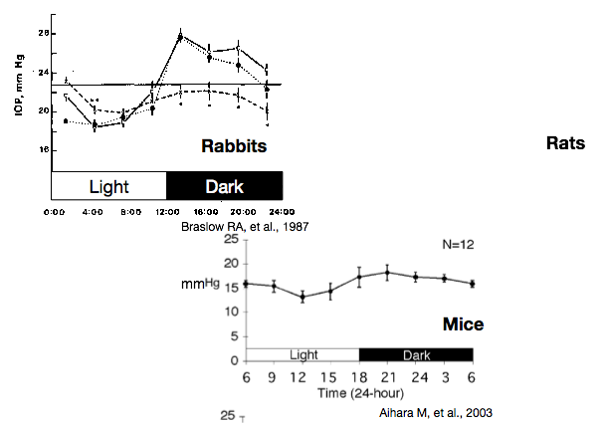
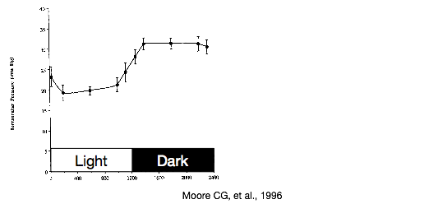
実験動物の眼圧日内変動
Diurnal IOP variation in experimental animals
Rabbits
Rats
Mice

